Slide 1
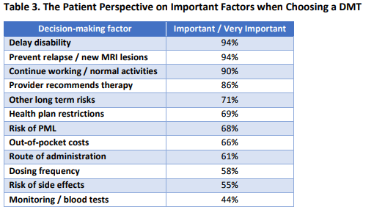
ICER and MS Coalition Survey

